Slide 1
Cyberminer – A web search engine Final
Team members:
Tingwei Wu txw190006
Churong Zhang cxz173430
Feifei Guo fxg180009
Qixiang Wang qxw200000

Slide 2
Functional Requirements(1)
FR1. Case sensitive search: The system shall store the input as given and retrieve the input also as such
FR2. Hyperlink enforcement: When the user clicks on the URL, which has been retrieved as the result of a query, the system shall take the user to the corresponding web site
FR3. Deletion of out-of-date URL: and corresponding description from the database
FR4. Multiple search engines: to run concurrently

Slide 3
Functional Requirements(2)
FR5. Setting the number of results to show per page, and navigation between pages
FR6. Listing of the query result in ascending alphabetical order; most frequently accessed order, or per payment
FR7. Autofill, while correcting typographical errors
FR8. Specifying OR/AND/NOT Search
FR9. Filtering out symbols that are not meaningful, according to the user configuration

Slide 4
Non-Functional Requirements
NFR1. Easily understandable/User friendly: the interface shall be simple
NFR2. Portable: Cyberminer shall be a machine independent.
NFR3. Good performance: the system shall be efficient
NFR4. Responsive: the system shall be interactive

Slide 5
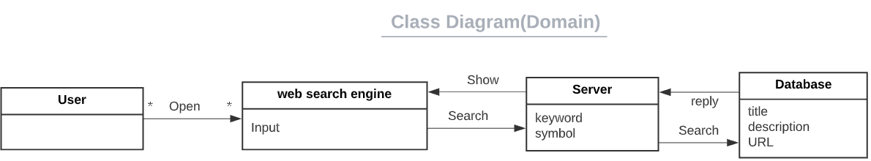
1. Domain Modeling & Requirements specification

Slide 6
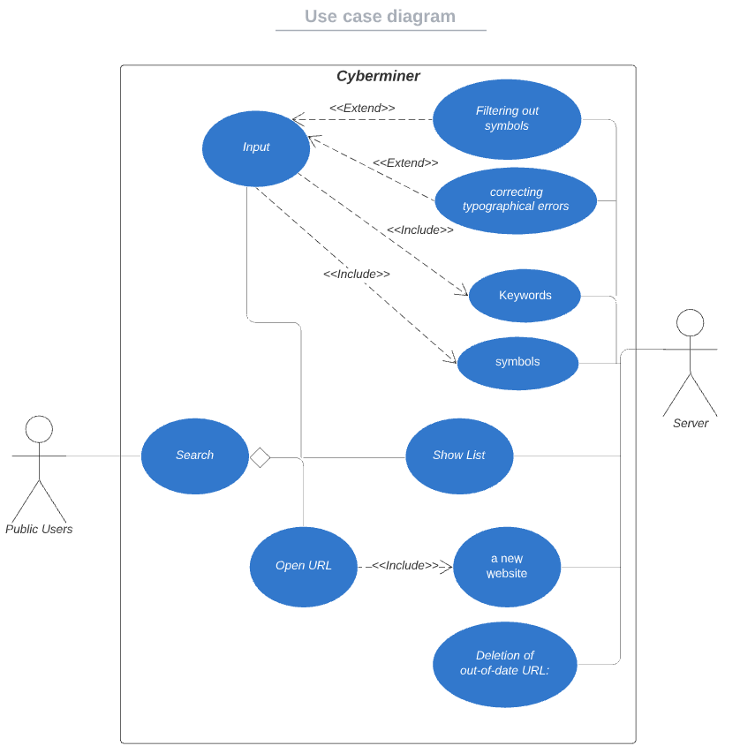
Main Use Case

Slide 7
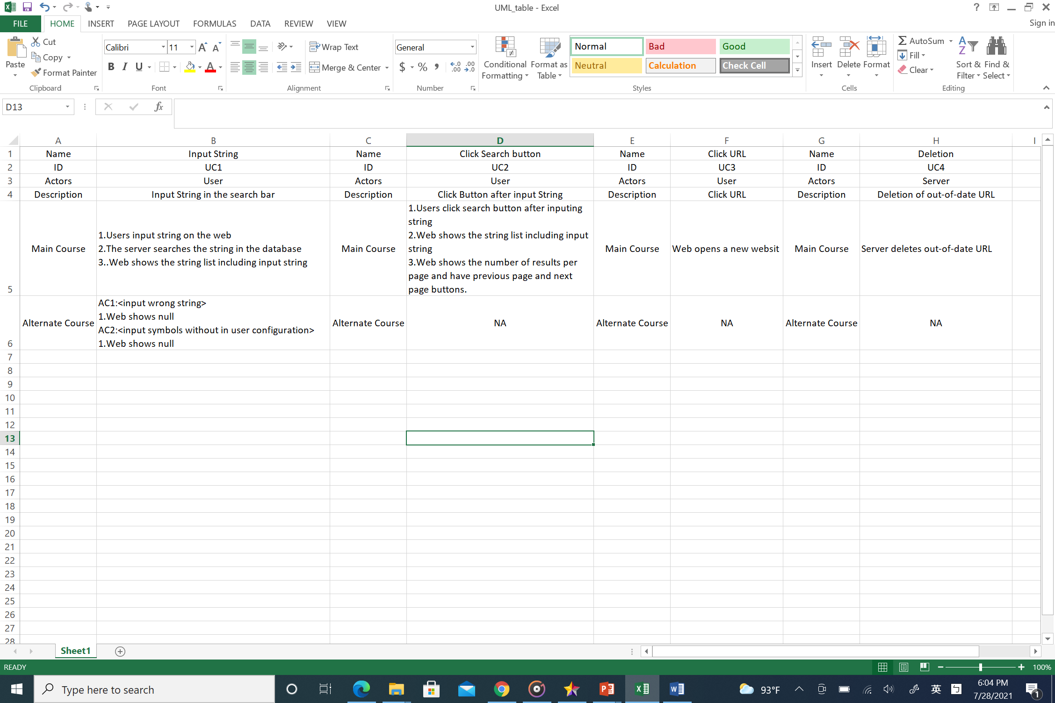
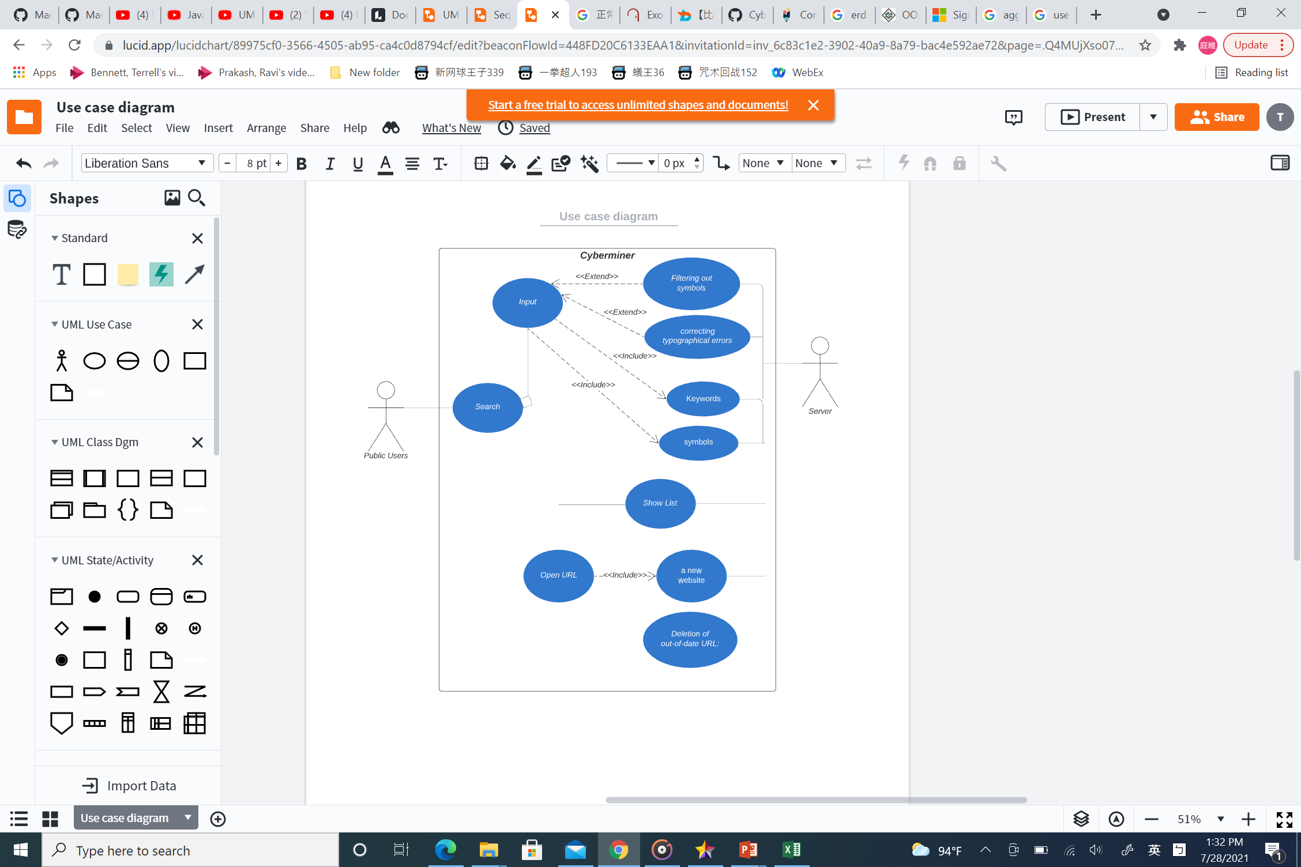
Use Case 1

Slide 8
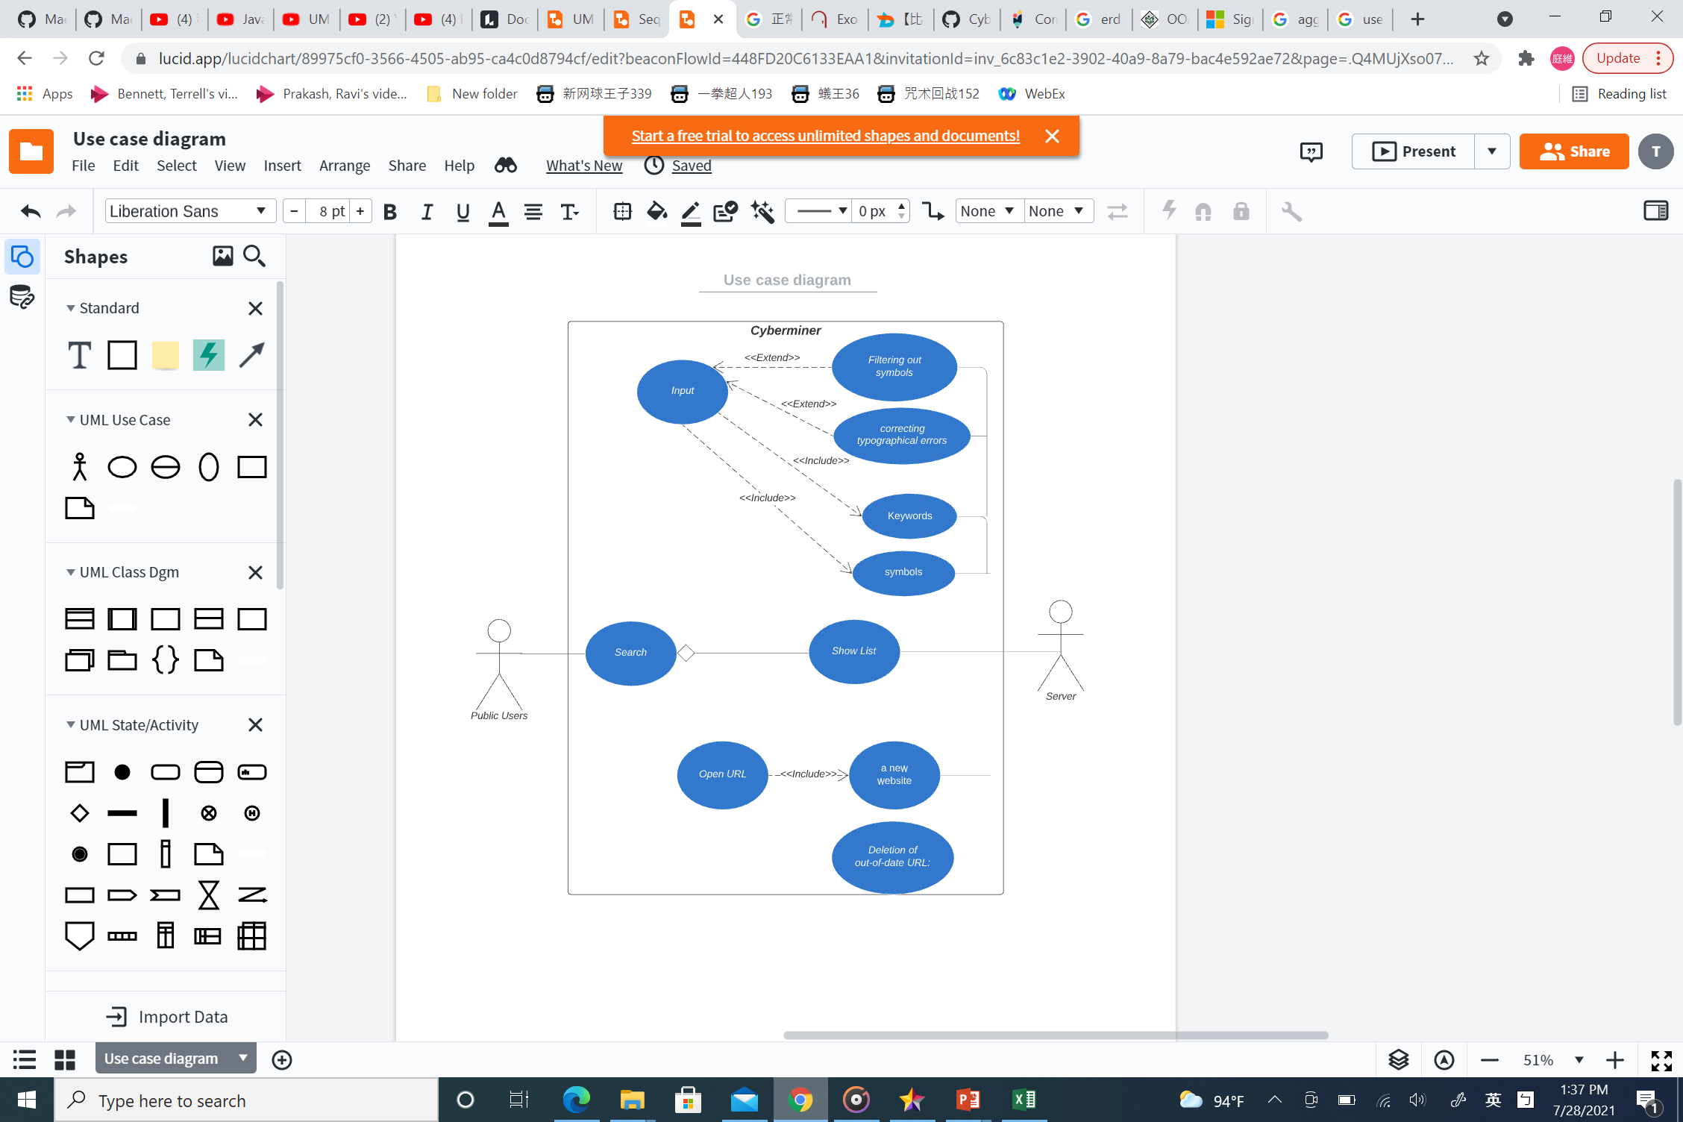
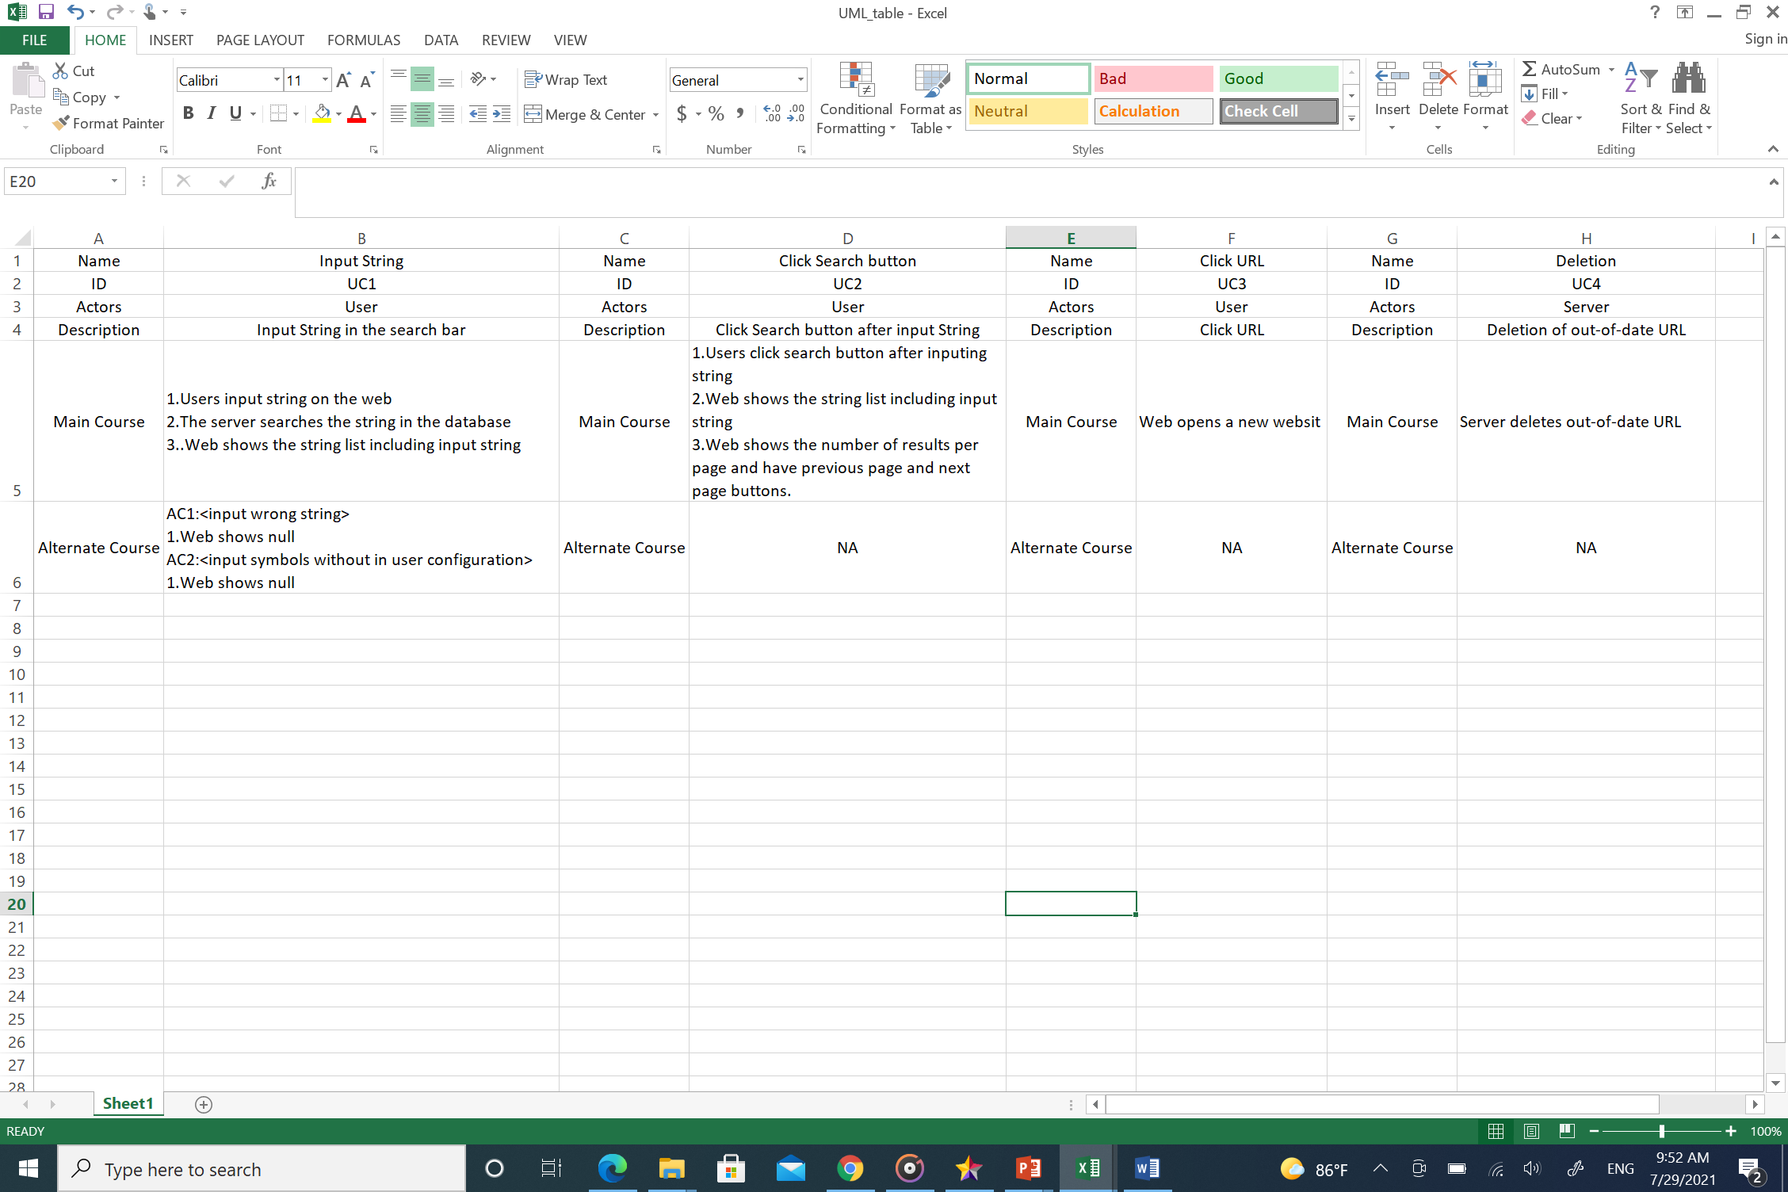
Use Case 2

Slide 9
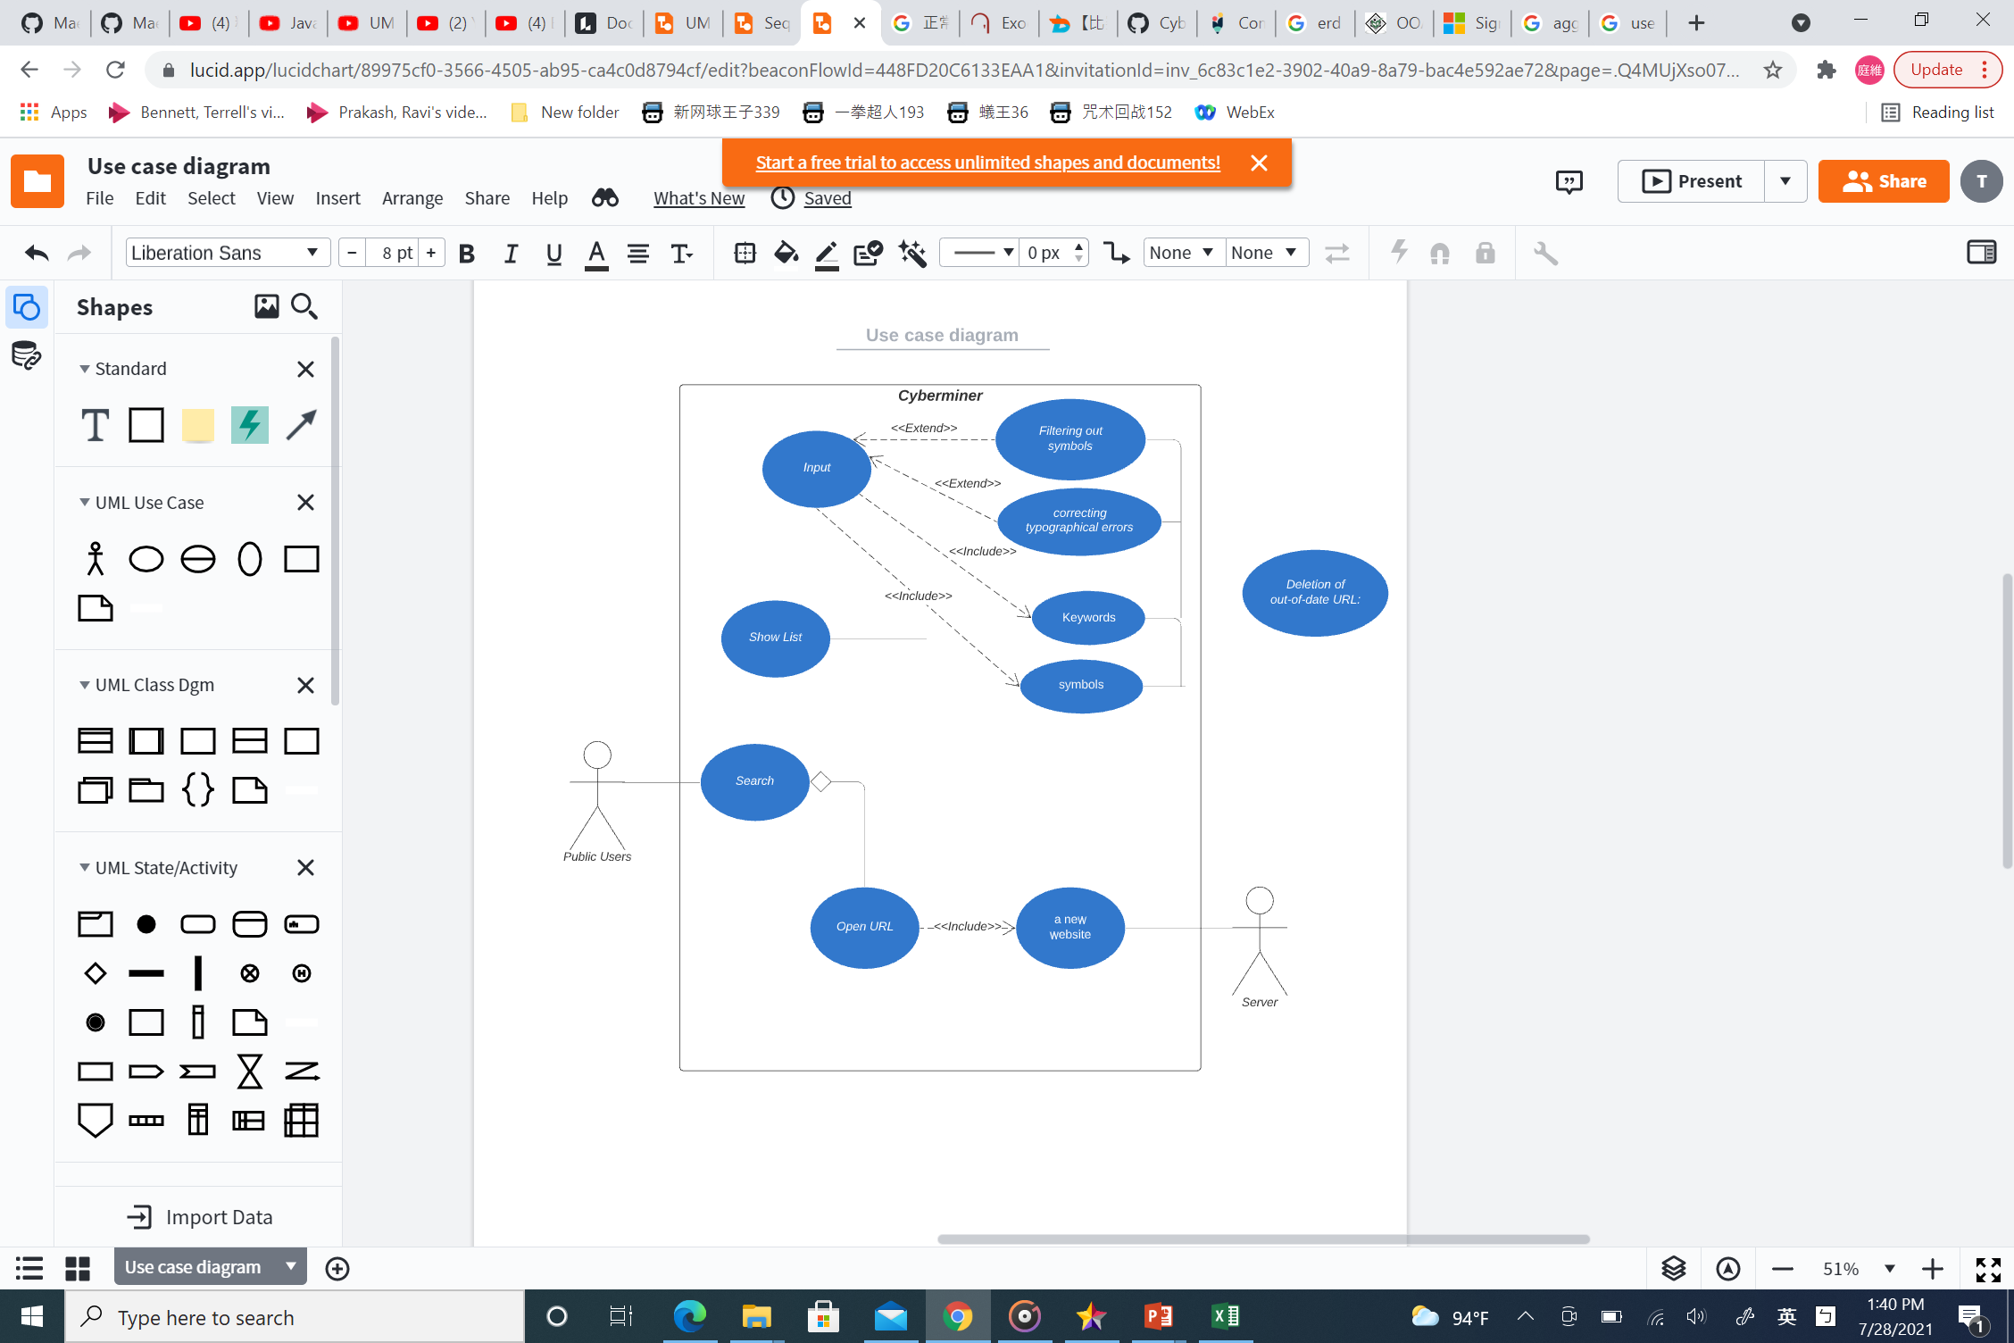
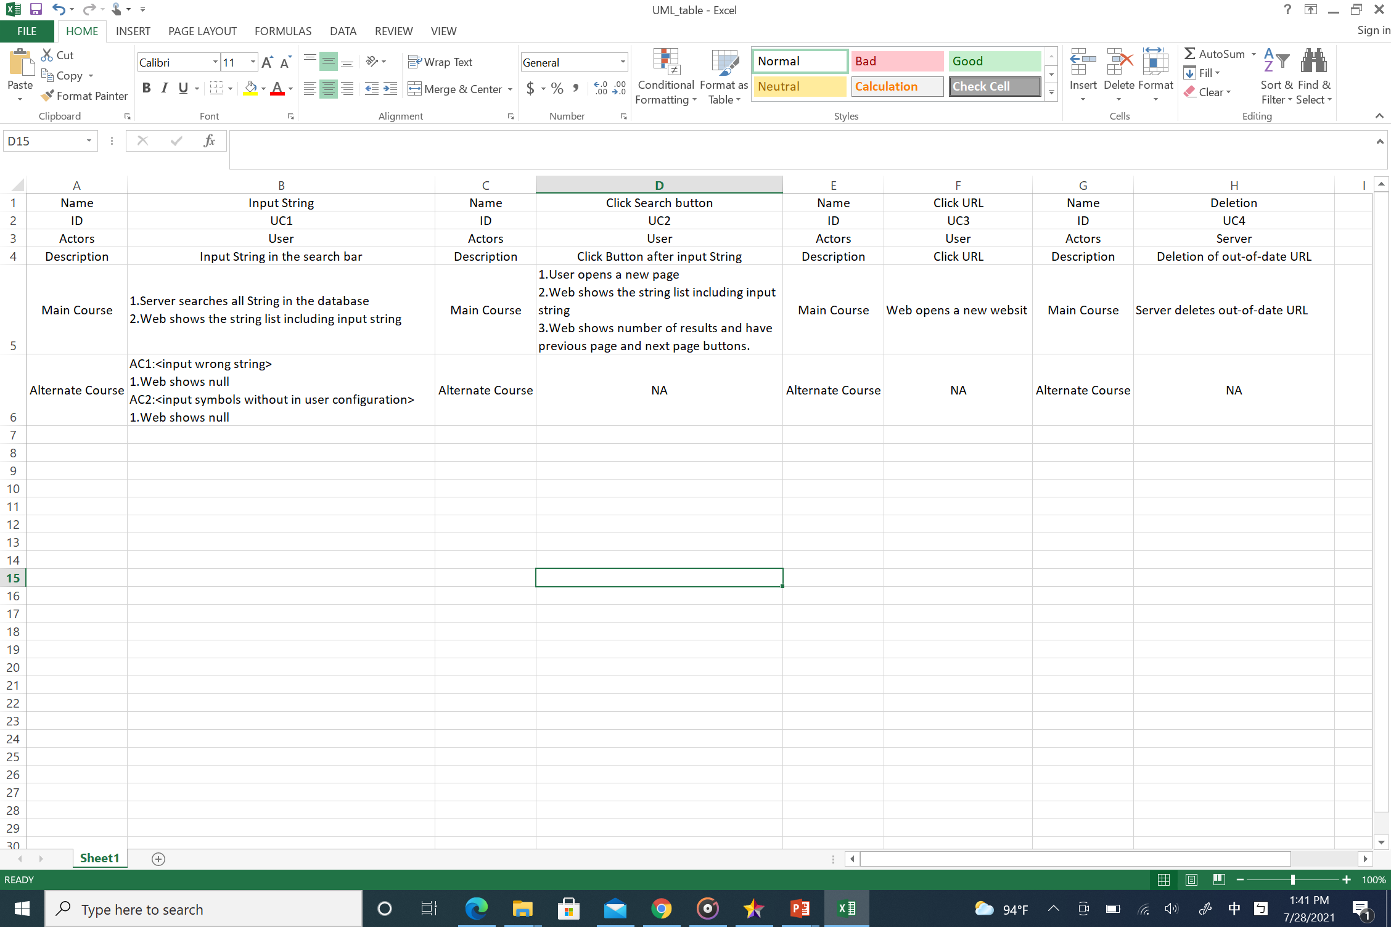
Use Case 3

Slide 10
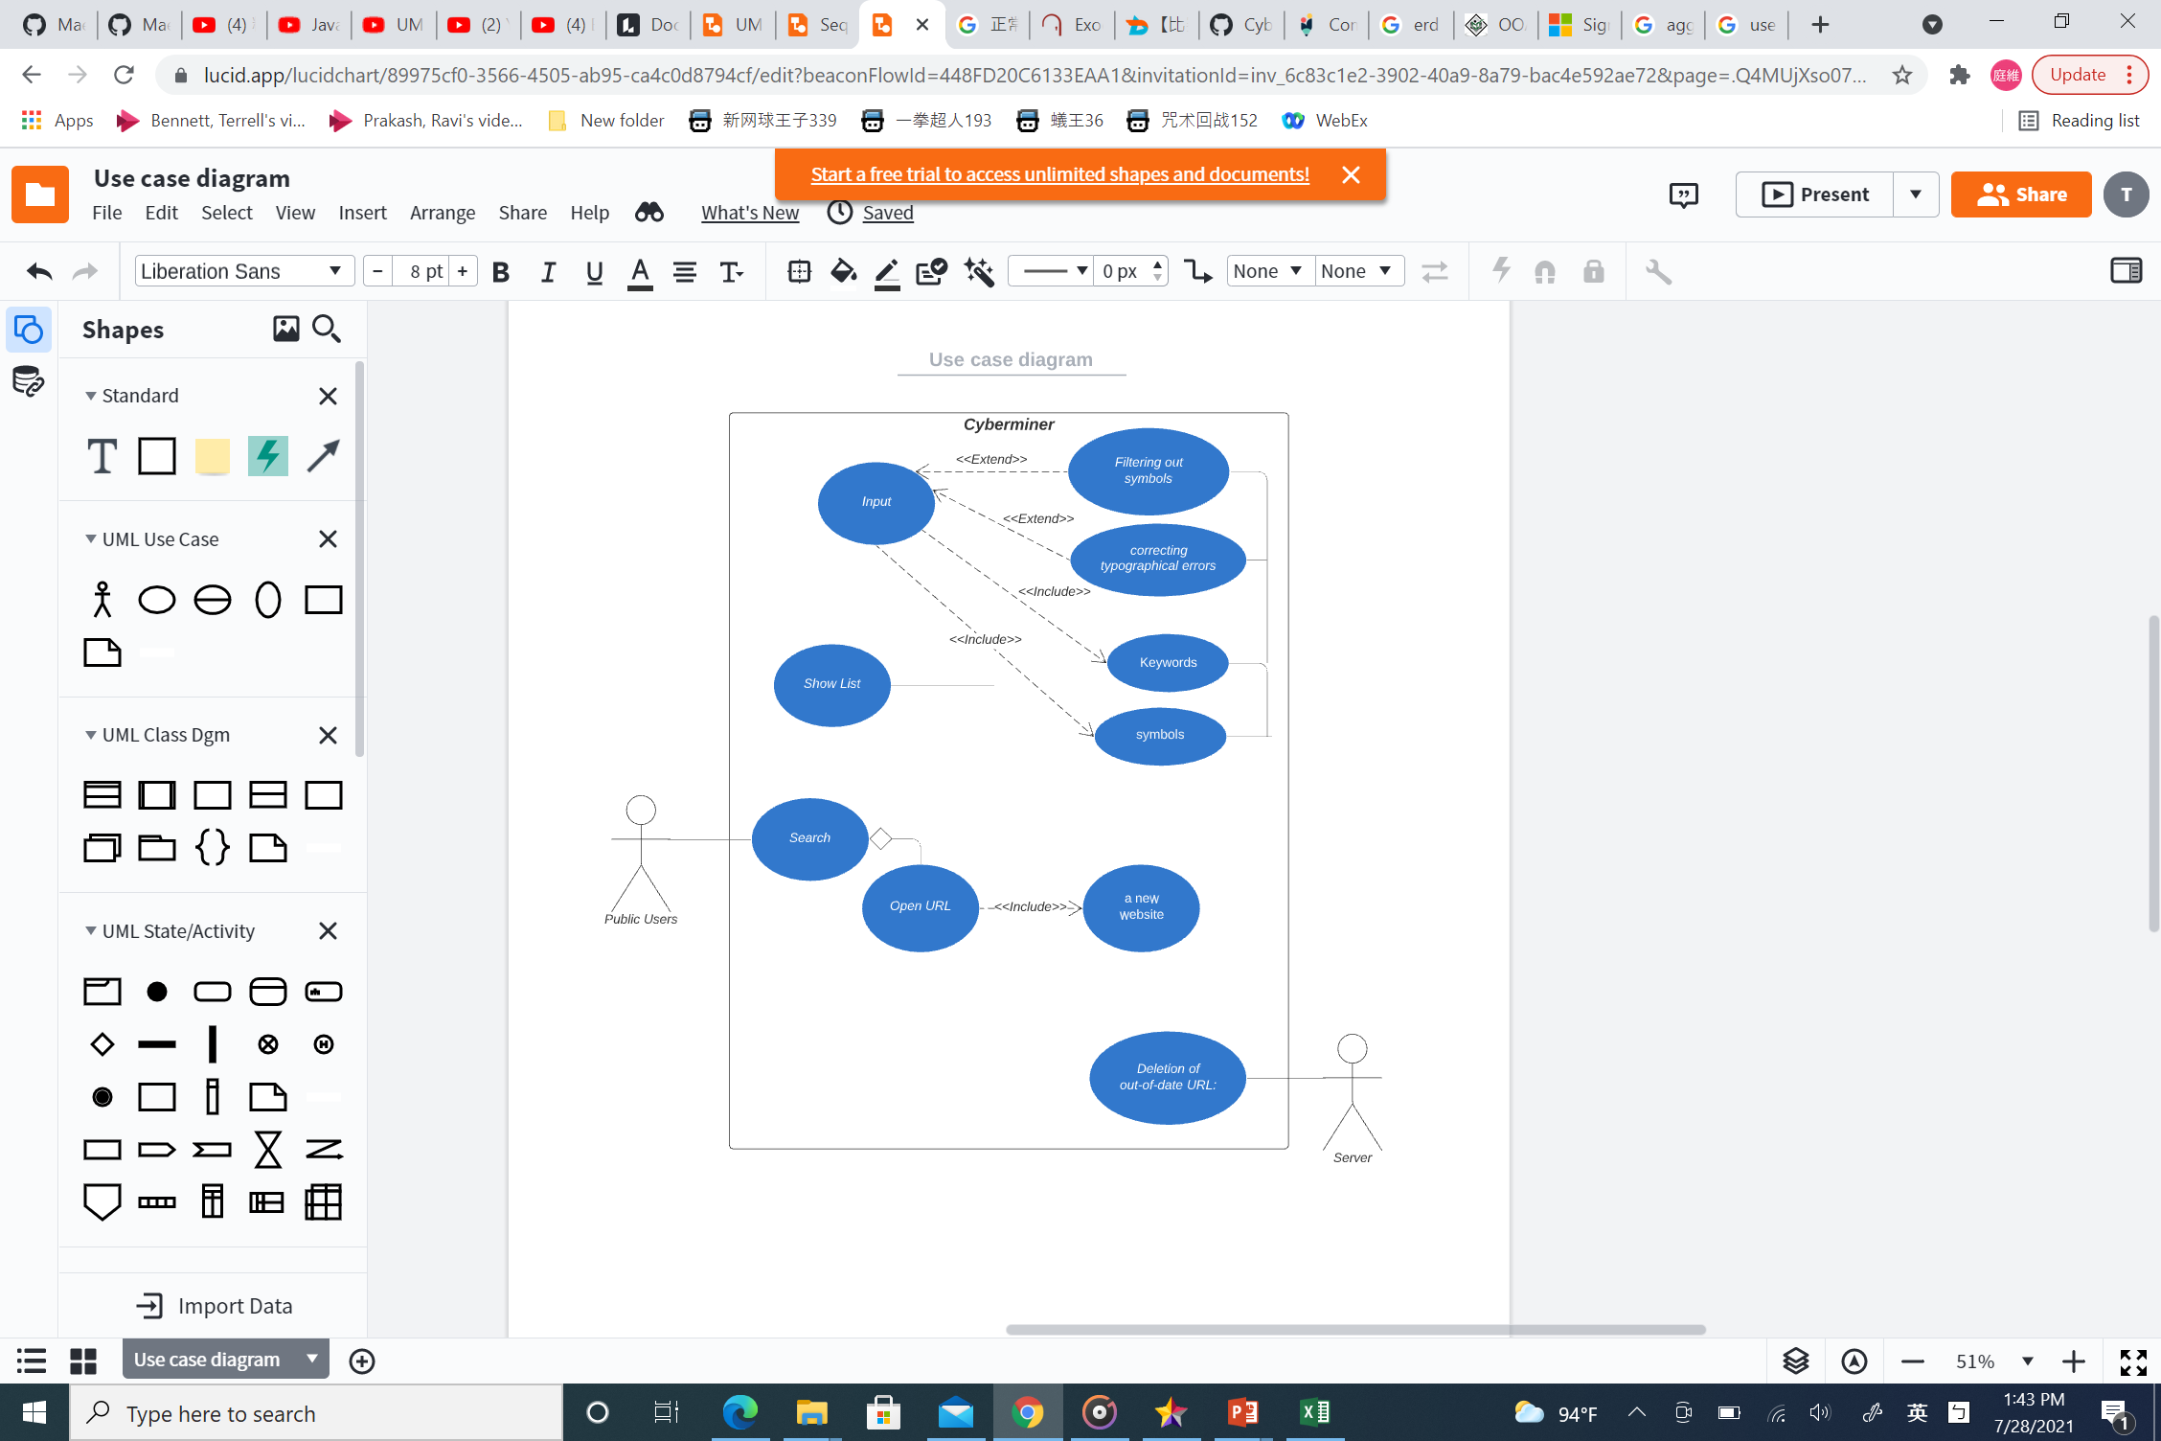
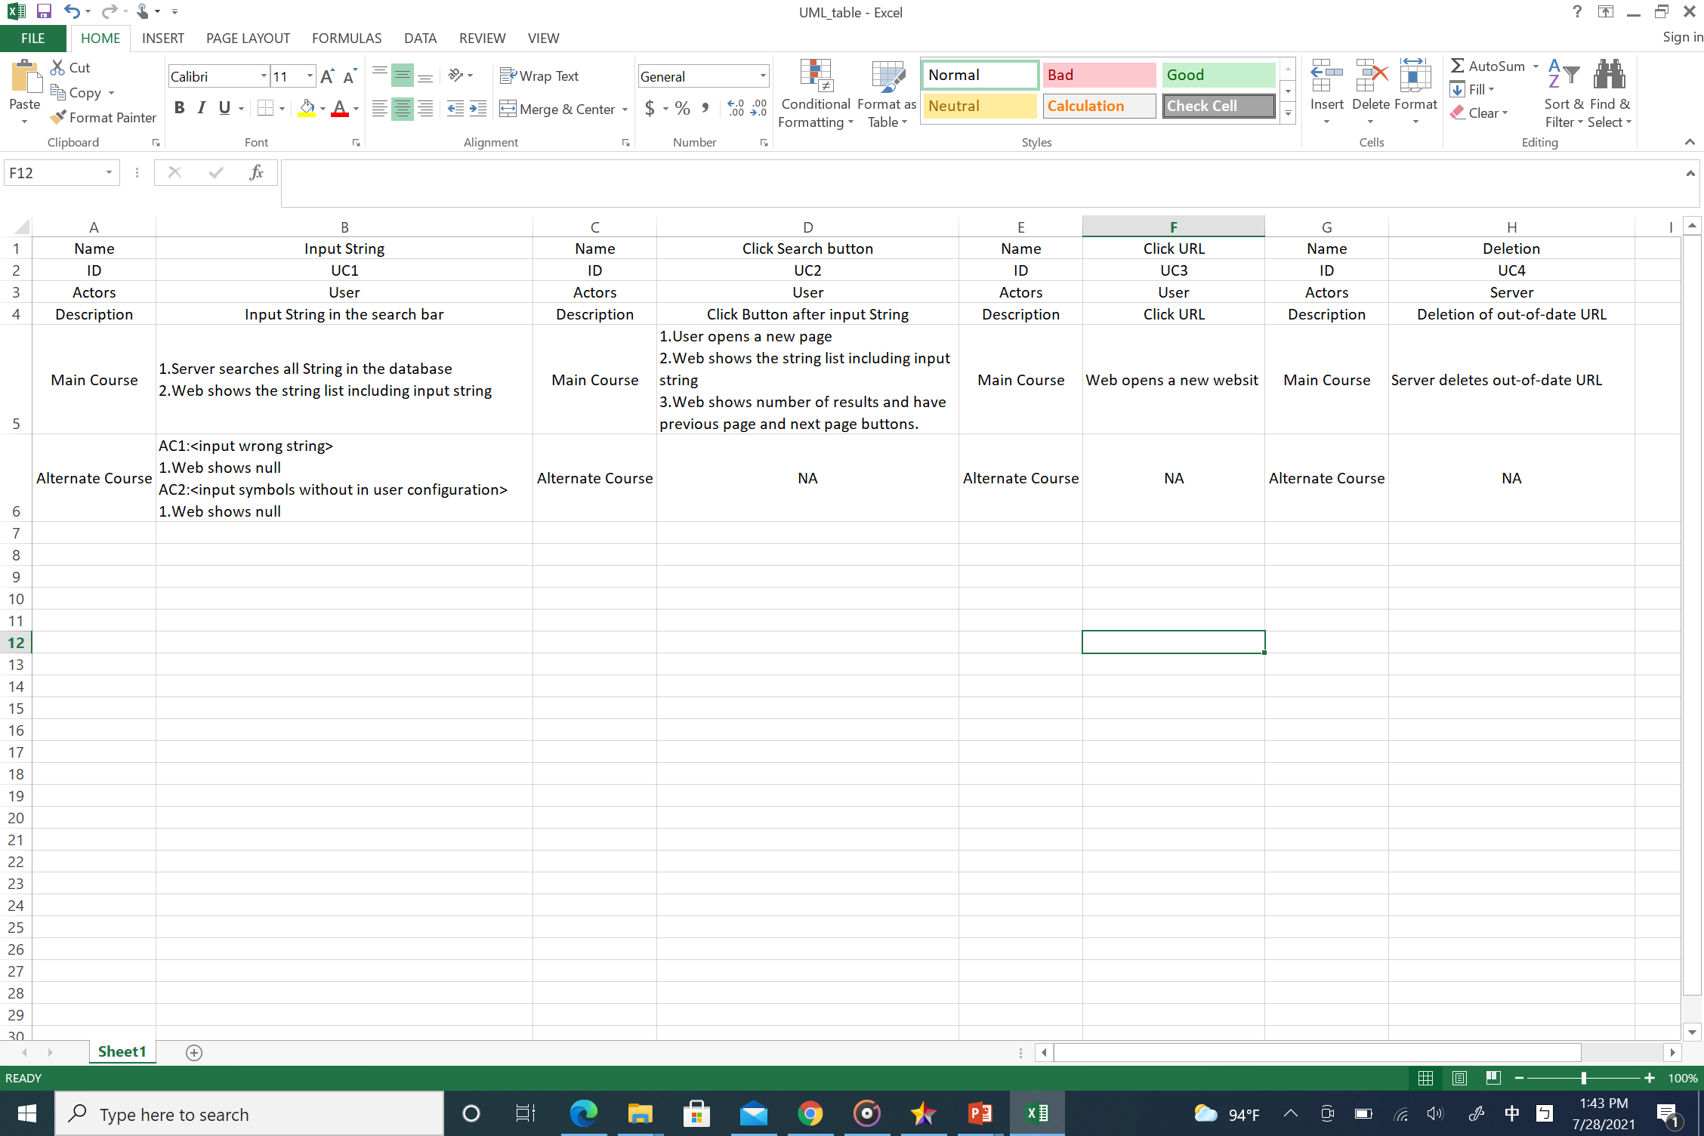
Use Case 4

Slide 11
2. Design specification

Slide 12
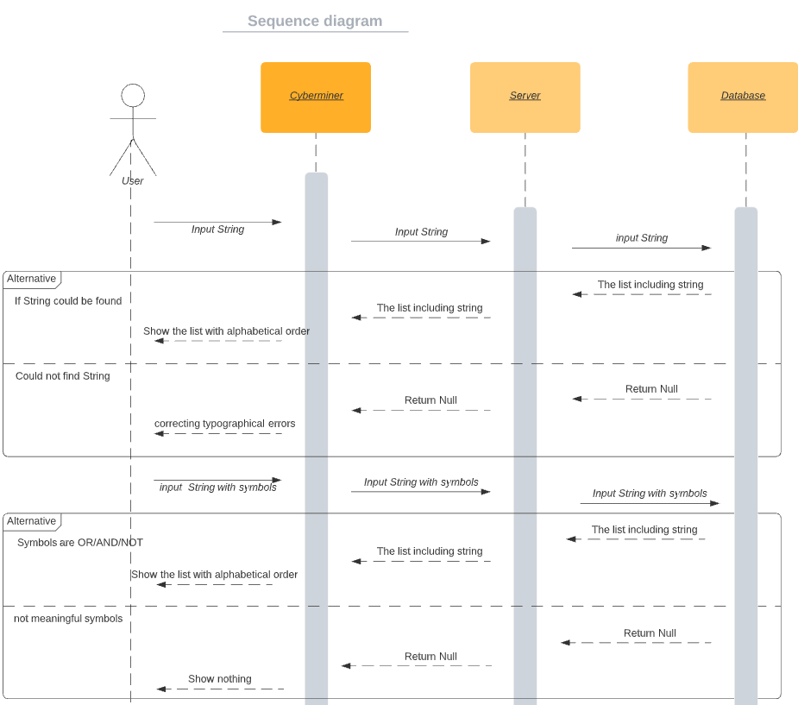
Sequence Diagram(1)
Use Case 1(Input String)

Slide 13

Sequence Diagram(2)
Use Case 2(click Search button)

Slide 14

Sequence Diagram(3)
Use Case 3(click URL)

Slide 15
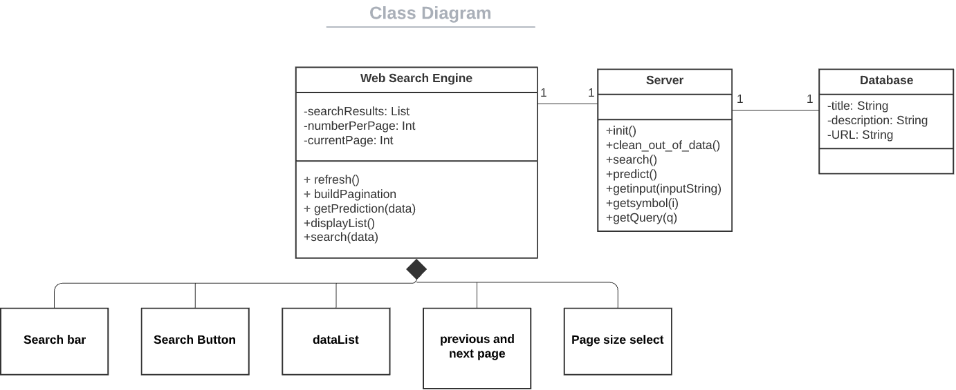
Class Diagram

Slide 16
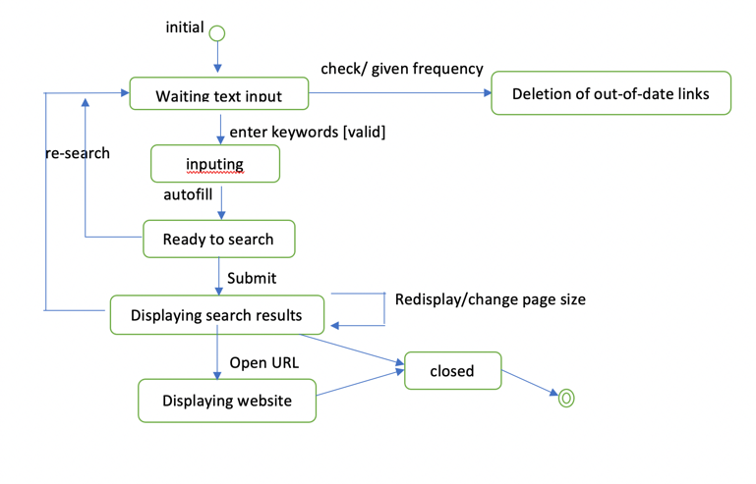
State Transition Diagram

Slide 17
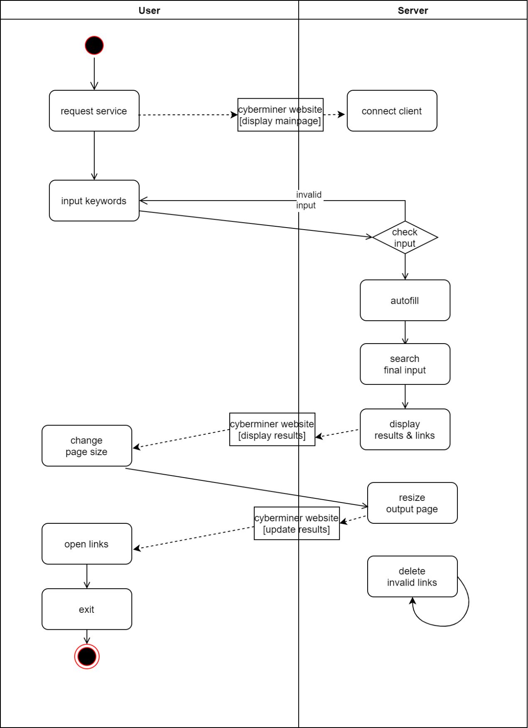
Activity Diagram

Slide 18
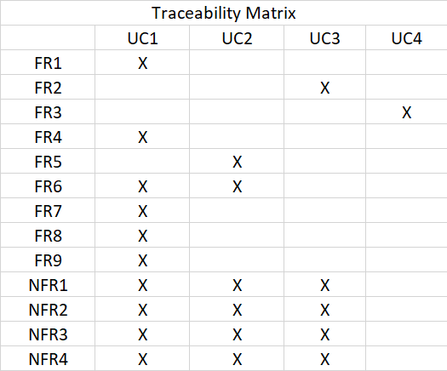

Slide 19

3. User Manual
Download and Install MAMP
Activate Apache and MYSQL Server

Slide 20
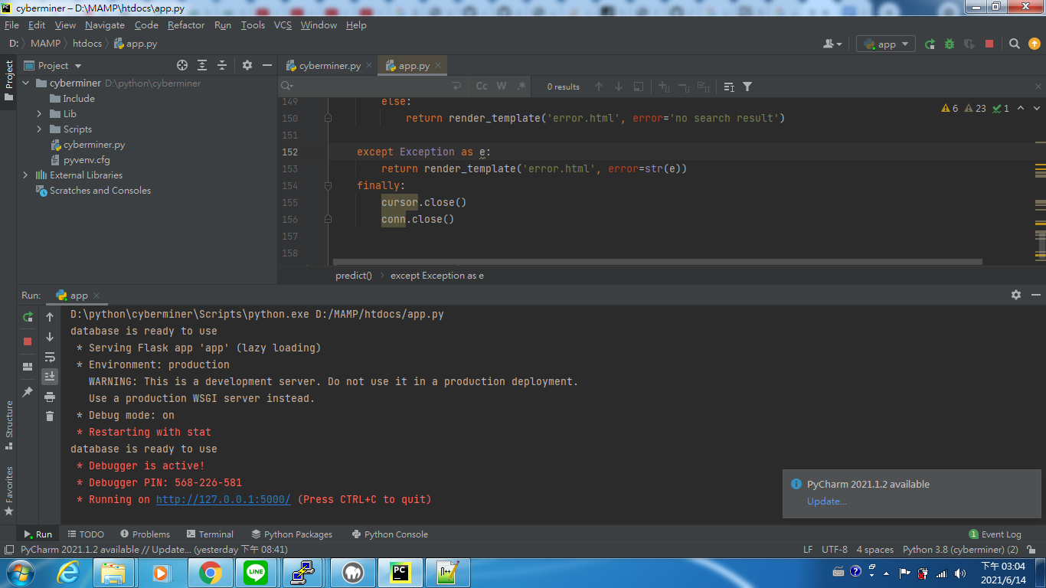
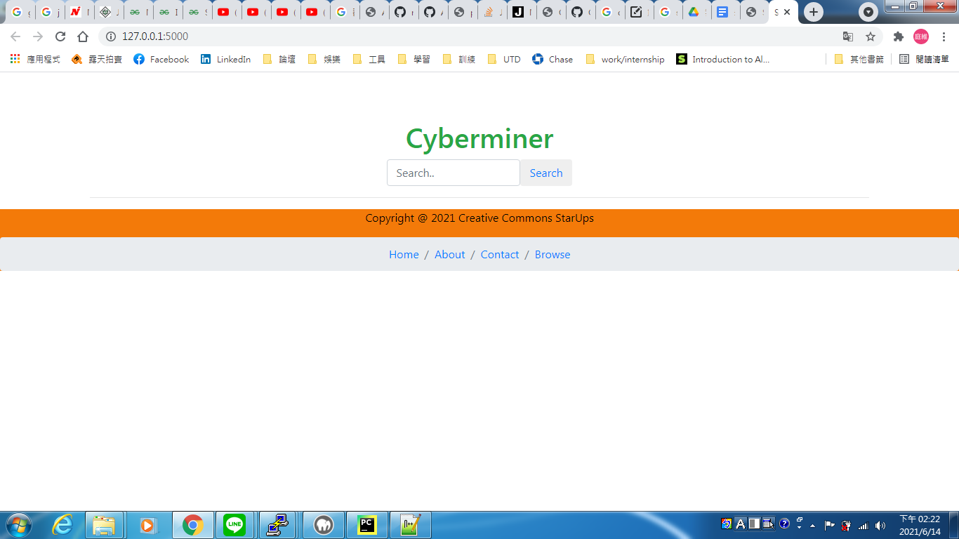
Execute app.py
Open the URL

Slide 21
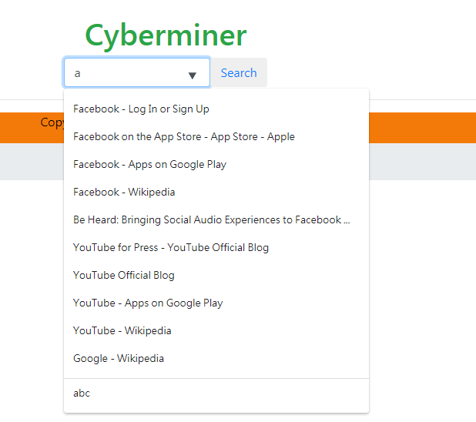
Input String and showing String in the Database

Slide 22
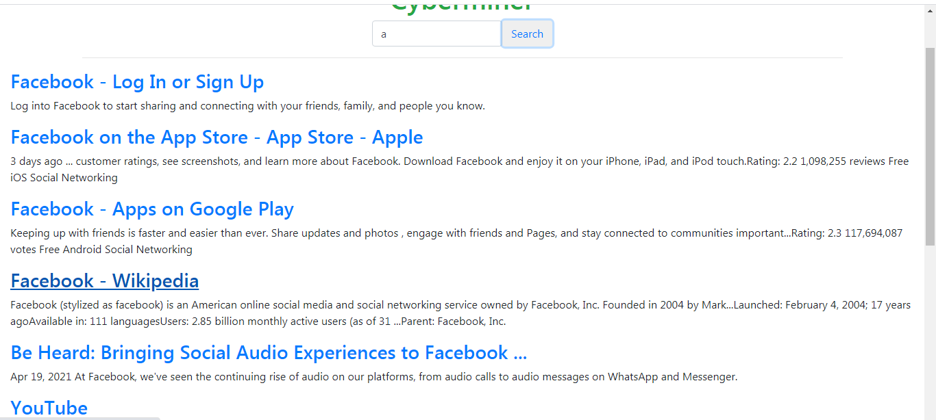
Click Search button and show the results

Slide 23
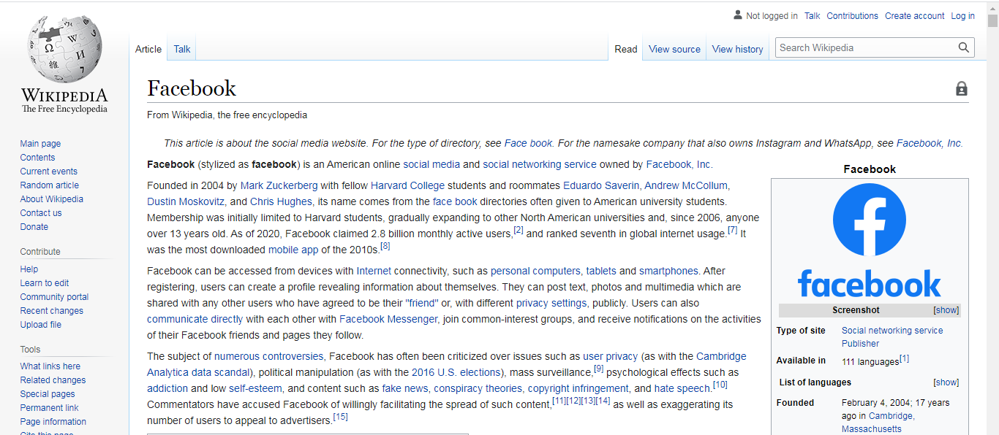
Click Facebook – Wikipedia

Slide 24
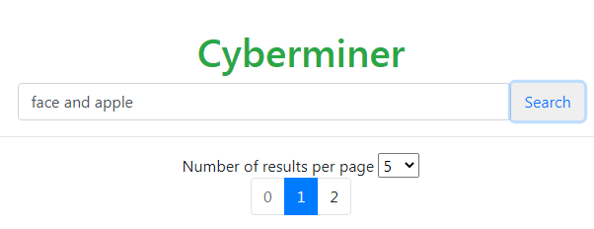
Use AND to search
Can’t find both face and apple at the same time

Slide 25
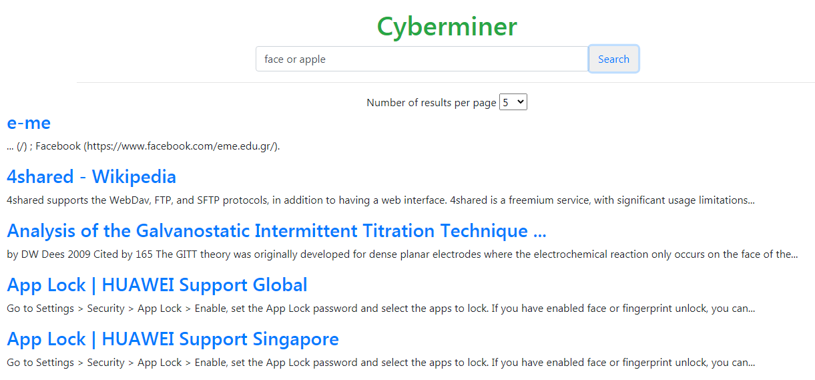
Use OR to search
find one of them

Slide 26
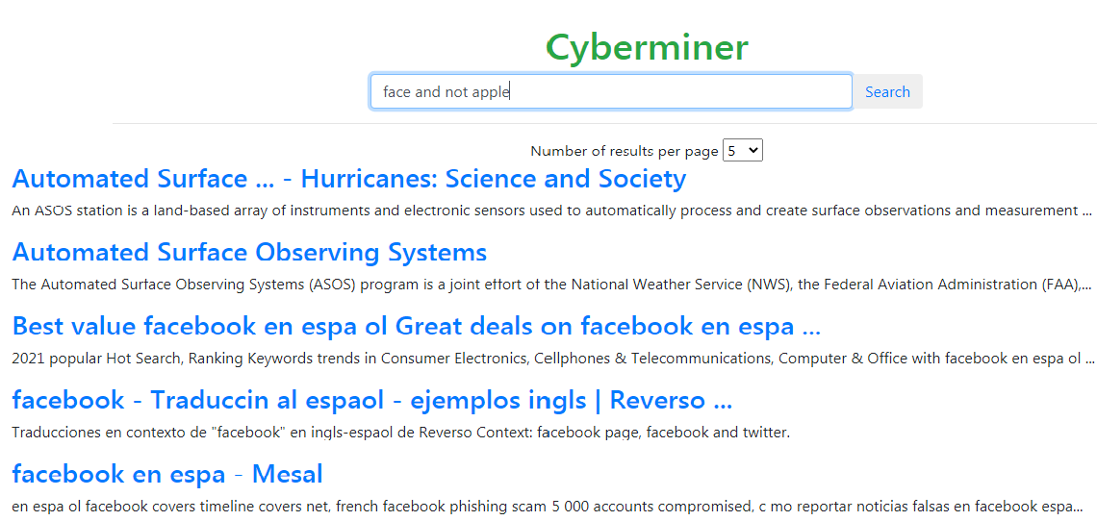
Use NOT to search
In our system, have to use “and not” or “or not”
The result will show string including face not apple

Slide 27
DEMO

Slide 28
END

